Slide 1
Course Overview
BWSI: Medlytics July 6th 2020
Notes:
1
1
Check distro statement before using:
DISTRIBUTION STATEMENT A. Approved for pubic release: distribution is unlimited.
This material is based upon work supported under Air Force Contract No. FA8721-05-C-0002 and/or FA8702-15-D-0001. Any opinions, findings, conclusions or recommendations expressed in this material are those of the author(s) and do not necessarily reflect the views of the U.S. Air Force.
© 2020 Massachusetts Institute of Technology.
Delivered to the U.S. Government with Unlimited Rights, as defined in DFARS Part 252.227-7013 or 7014 (Feb 2014). Notwithstanding any copyright notice, U.S. Government rights in this work are defined by DFARS 252.227-7013 or DFARS 252.227-7014 as detailed above. Use of this work other than as specifically authorized by the U.S. Government may violate any copyrights that exist in this work.

Slide 2

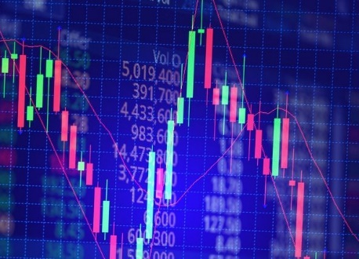
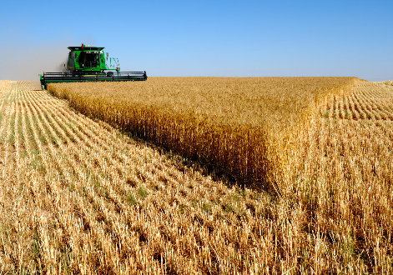
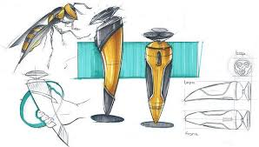
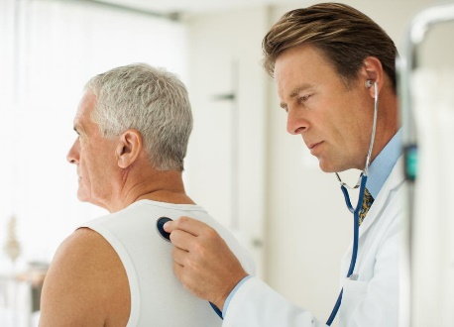
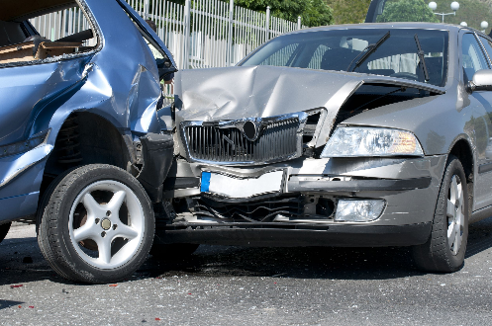
The Big Data Revolution
Marketing
Finance
Agriculture
Consumer behavior
Market predictions
Resource management
Design
Healthcare
Insurance
Feature abstraction
Diagnosis
Risk assessment

Slide 3
The Big Data Revolution
Marketing
Finance
Agriculture
Consumer behavior
Market predictions
Resource management
Design
Healthcare
Insurance
Feature abstraction
Diagnosis
Risk assessment
Focus of this course

Slide 4
The Data Science Intersection
Domain
Knowledge
Hypothesis generation
Feature identification
Data collection
Data structures
Preprocessing
Algorithm engineering
Data Science
Computer Science
Math &
Statistics
Model definitions
Fitting methods
Hypothesis testing

Slide 5
The Data Science Intersection
Domain
Knowledge
Hypothesis generation
Feature identification
Data collection
Data structures
Preprocessing
Algorithm engineering
Data Science
Computer Science
Math &
Statistics
Medlytics
Model definitions
Fitting methods
Hypothesis testing

Slide 6
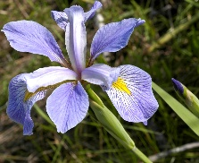
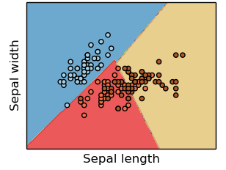
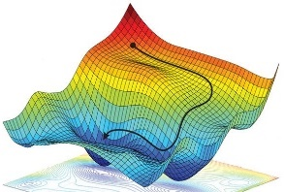
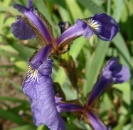
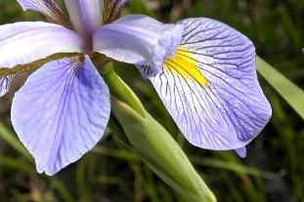
Necessary Components of a Supervised Machine Learning Approach
Training Data
Feature
Selection
Cost Function
Training Algorithm
Model Type
p
s
IrVi
IrSe
Set of labeled samples
Method to select data characteristics critical information
The form of model which will be trained to make decisions
Metric by which a prospective models should be judged
Algorithm to minimize the cost function by tuning model parameters
Description
- Tabular data
- Time-series
- Images
- Videos
- Text samples
- Intuition
- Expert knowledge
- Statistics
- Learned features
- Regression
- Nearest neighbor
- Decision tree
- SVM
- Neural Network
- Squared error
- Absolute error
- Cross-entropy
- Accuracy
- Gradient descent
- Gradient-free opt.
- Analytic solution
Examples
Supervised machine learning approaches require each of these components
* image sources: scikit-learn (for “model type”) and https://reconsider.news/2018/05/09/ai-researchers-allege-machine-learning-alchemy (for “training algorithm”)

Slide 7
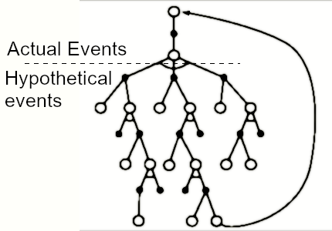
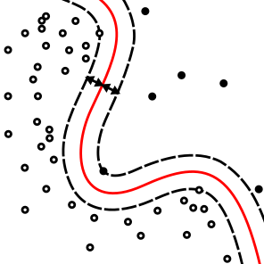
The Flavors of Artificial Intelligence
Artificial Intelligence (AI)
Any computer programs which mimics human behavior
Machine Learning (ML)
AI programs with decision making rules inferred from example (training) data
Deep Learning
Use multi-layered (deep) neural networks
Pruned Search Tree
Support Vector Machine
Neural Network

Slide 8
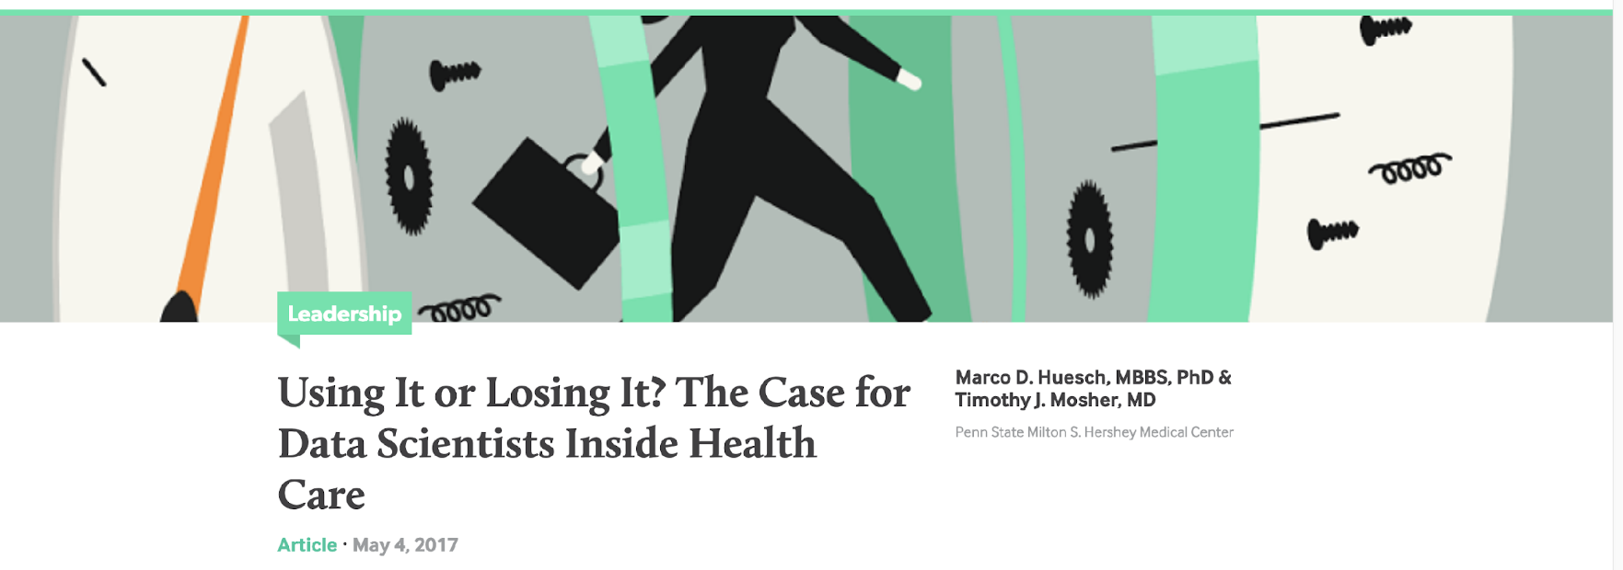
Group Exercise
Split into breakout room. Groups should identify 2-3 examples where data (big or small) has:
Revolutionized clinical practice
Modified health care guidelines
Changed drug development
If you have a personal story share that
Report back to the class (pick a spokesperson)

Slide 9
Outline
Introduction
Week 1: Basics of Data Analysis
Week 2: AI and Signal Processing
Week 3: Computer Vision and Deep Learning
Week 4: Capstone project

Slide 10
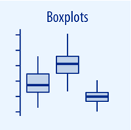
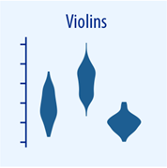
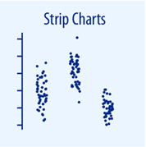
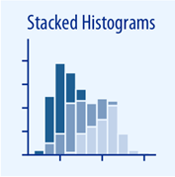
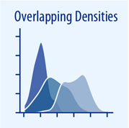
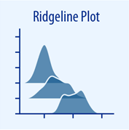
Data Visualization
• The same data can be visualized many different ways
Boxplots
Violin
Strip Charts
Stacked Histograms
Overlapping Densities
Ridgeline Plot
Different visualization may highlight different characteristics

Slide 11
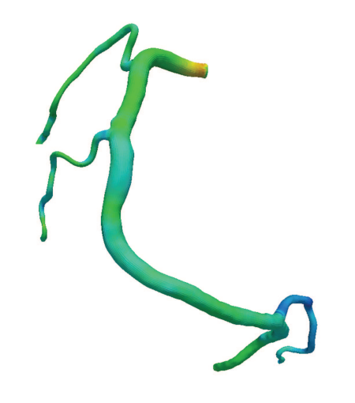
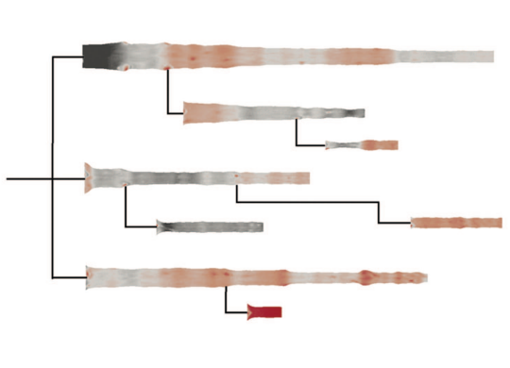
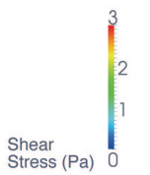
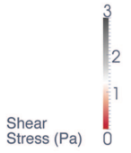
Different Visualizations of the Same Data
• One set of arterial stress measurements • Two different visualizations
3D + Rainbow Colors
2D + Diverging Colors
39% True Positive Rate
91% True Positive Rate
Some visualizations achieve specific goals better than others
Borkin, Michelle, et al. “Evaluation of artery visualizations for heart disease diagnosis”

Slide 12
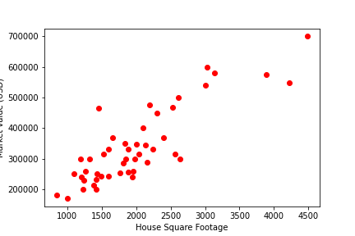
Regression and Classification
Regression
(e.g., line of best fit)
700
600
500
Market Value (1000x USD)
400
300
200
1000
1500
2000
2500
3000
3500
4000
4500
House Square Footage

Slide 13
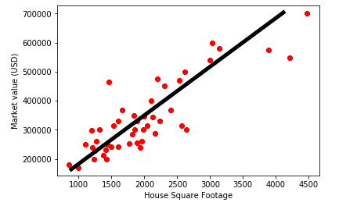
Regression and Classification
Regression
(e.g., line of best fit)
700
600
500
Market Value (1000x USD)
400
300
200
1000
1500
2000
2500
3000
3500
4000
4500
House Square Footage

Slide 14
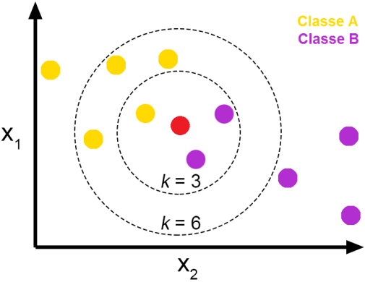
Regression and Classification
Regression
Classification
(e.g., line of best fit)
(e.g., k-nearest neighbors)
700
600
500
Market Value (1000x USD)
400
300
200
1000
1500
2000
2500
3000
3500
4000
4500
House Square Footage

Slide 15
Regression and Classification
Regression
Classification
(e.g., line of best fit)
(e.g., k-nearest neighbors)
700
600
500
Market Value (1000x USD)
400
300
200
1000
1500
2000
2500
3000
3500
4000
4500
House Square Footage
Which class?

Slide 16
Outline
Introduction
Week 1: Basics of Data Analysis
Week 2: AI and Signal Processing
Week 3: Computer Vision and Deep Learning
Week 4: Capstone project

Slide 17

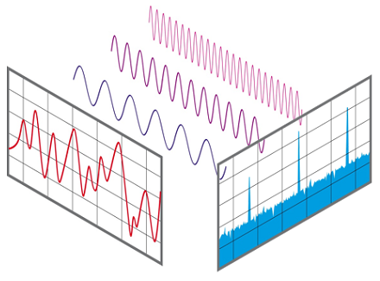
Time Series and Signal Processing
Decomposing a Signal Into Constituent Parts
Fourier Transform
Temporal
Frequency
Time

Slide 18
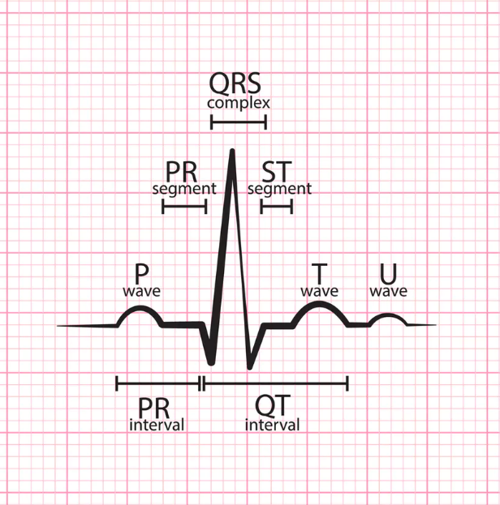
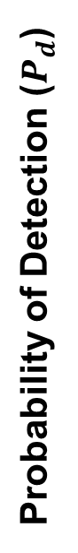
Feature Engineering for Disease Detection
• Explore alternative early indicators of infection • Improve on conventional approach
Ideal Signal
Novel Signal for Detection (e.g., ECG monitoring)
Novel Signal
Conventional Signal (e.g., fever)
Detection Threshold
Probability of Detection ($P_{d}$)
Time after Infection
Monitoring physiological signals may enable earlier detection of infection (influenza, COVID-19, etc…)

Slide 19
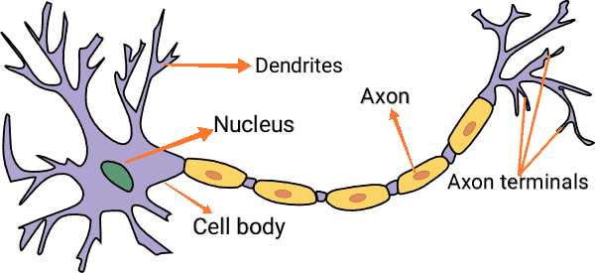
Introduction to Neural Networks
• Loosely Modeled After Animal Neurology • Large training set required for training
Individual (Animal) Neuron
Network of Many Artificial Neurons
Each neuron connects to many others
Neuron fires if voltage exceeds threshold
Map raw data inputs to arbitrary outputs
Able to model highly complicated relationships

Slide 20
Outline
Introduction
Week 1: Basics of Data Analysis
Week 2: AI and Signal Processing
Week 3: Computer Vision and Deep Learning
Week 4: Capstone project

Slide 21
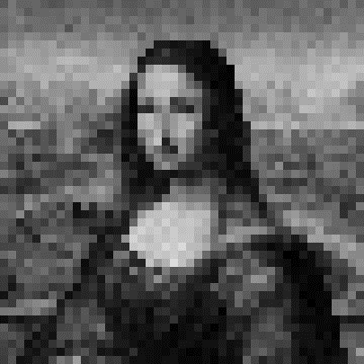
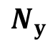

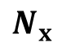
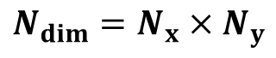
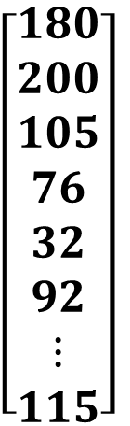
Statistical Image Analysis
• Multiple representations of the same image data
Standard 2D Format
Flattened Vector Format
$$N_{x}$$
$$N_{dim}=N_{x}×N_{y}$$
$N_{dim}$ dimensional image space
$$\left[\begin{aligned}180 \\ 200 \\ 105 \\ 76 \\ 32 \\ 92 \\ ⋮ \\ 115\end{aligned}\right]$$
Class A
Class B
$$N_{y}$$
each image is a single position
colors represent pixel values
vector values represent pixel values
each pixel is an axis

Slide 22
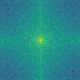
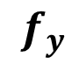

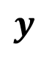

Signal Processing for Images
Raw Image Data
Fourier Transform (FT)
Spatial Frequency Data
$$y$$
$$f_{y}$$
Spatial Frequency
$$x$$
Position
$$f_{y}$$

Slide 23
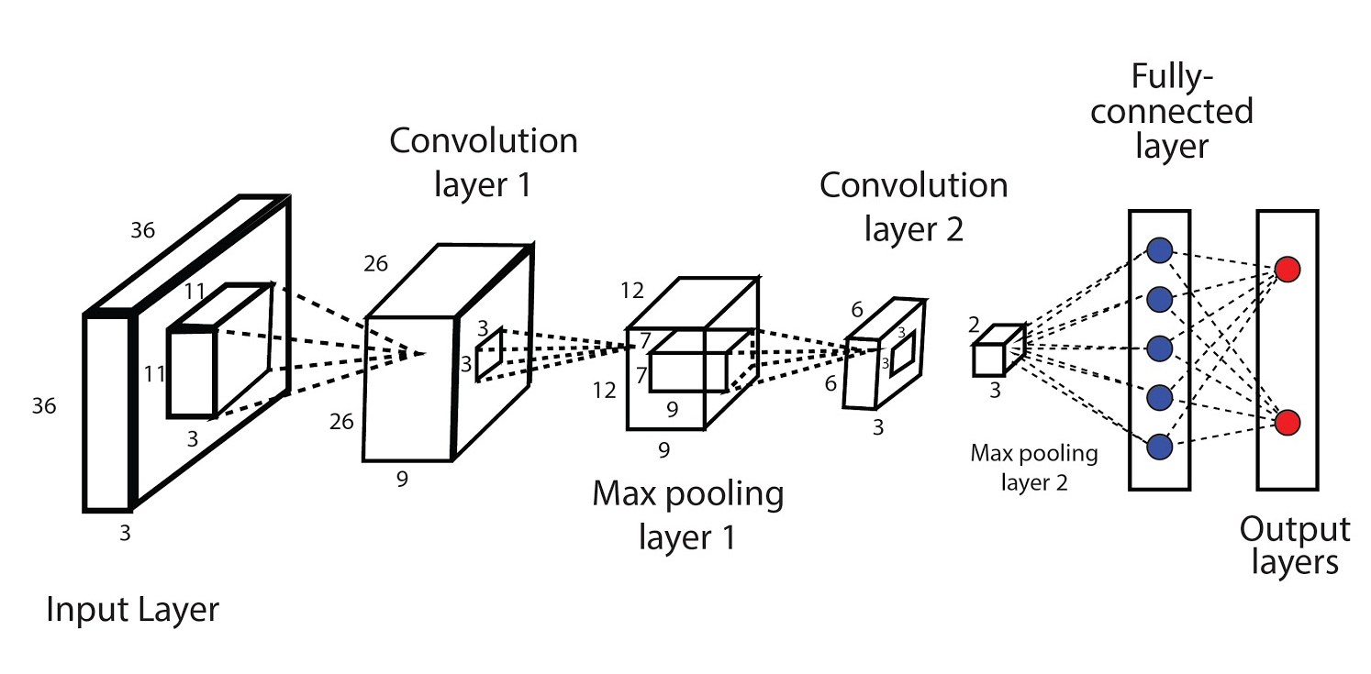
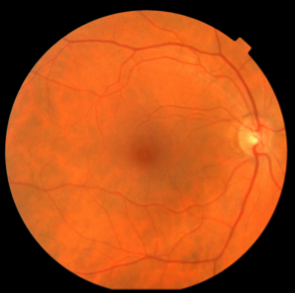
Convolutional Neural Network (CNN)
Apply FT-like Operations
Combine Components
Input Raw Image Data
Output Image Classification
Healthy
Unhealthy
Image Components
Compound Features

Slide 24
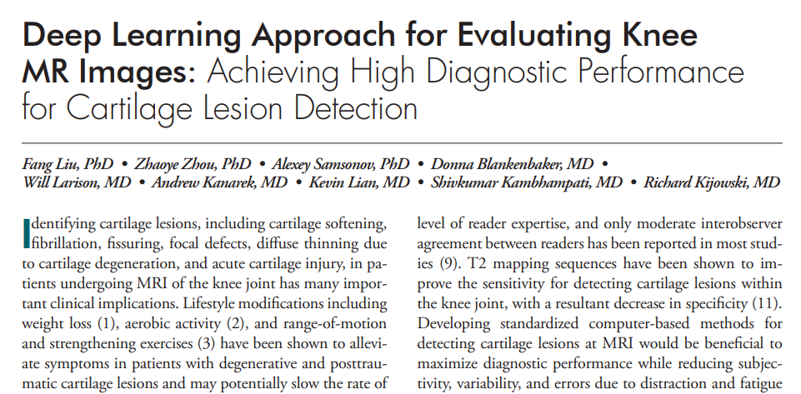
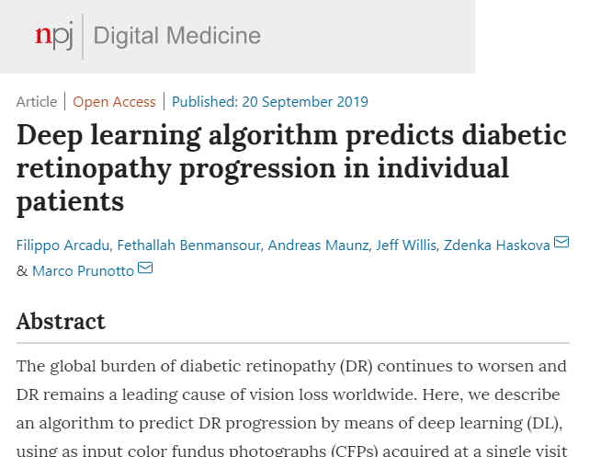
Deep Learning for Disease Detection
Rapidly build AI detectors using large datasets
Quickly deploy high quality services in developing world
Often outperform human doctors with years of training

Slide 25
Outline
Introduction
Week 1: Basics of Data Analysis
Week 2: AI and Signal Processing
Week 3: Computer Vision and Deep Learning
Week 4: Capstone project

Slide 26
You Design a Novel Medical Application
Description
Schedule
End Goal: create a video essay
Something achievable in 1 week
Easier said than done
Instructors are here to help you with this
Tools:
PowerPoint / Google Slides
Jupyter Notebooks
“ShareX” or “ActivePresenter” (screen capture)
Audacity (audio capture and editing)
Mon: Brainstorm a medicine analysis idea
Pitch idea to instructors
Get feedback, iterate, and refine project
Tue: Start your project work
Obtain necessary data
Tools from the previous weeks (and new variations)
Wed: Mid-week check-in
Minor adjustments to project goal
Instructors help clear any major obstacles
Thur: Continue project work
Begin recording and editing presentation
Fri: Finalize presentation
Due to Instructors by 5:00 PM
Sat: Present to full BWSI audience

Slide 27
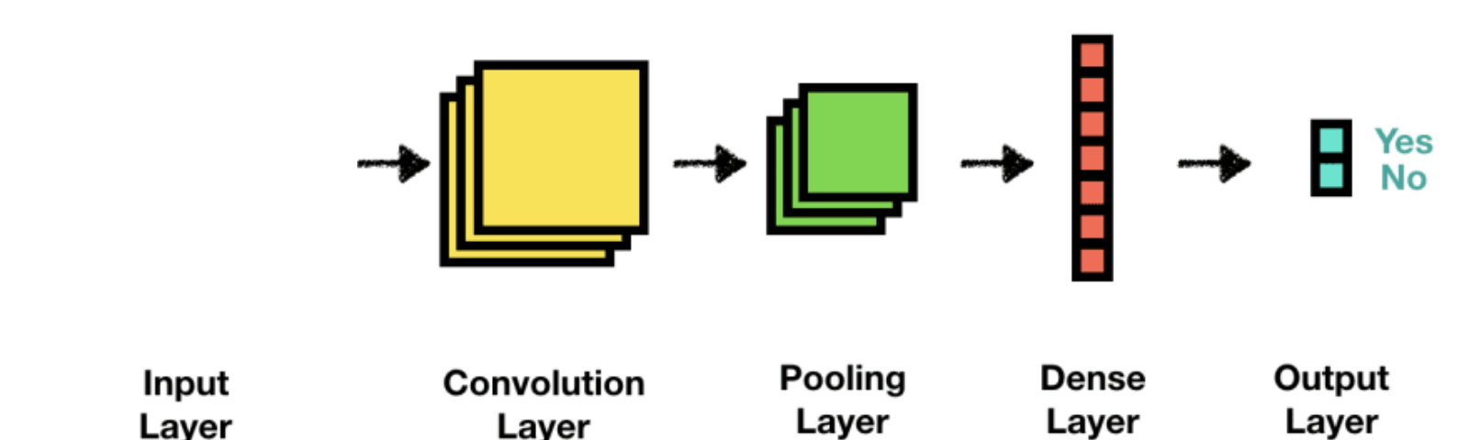
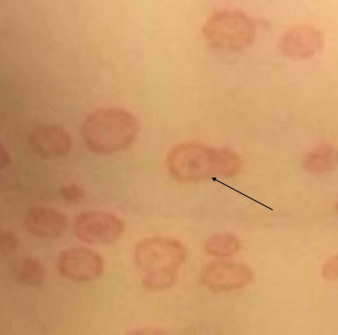
Skin Scanner Web App
Problem
Skin abnormalities seem frightening but can be easily diagnosed by a doctor. These patients take up expensive doctor time.
Solution
Build a web app to self diagnose the severity of a particular skin condition before meeting with a doctor.
Road Map
Tool: CNN
Data: DermNet images
Procedure: Iterate model architecture until good performance is achieved
Tinea
Final Model
74% accuracy

Slide 28

